Slide 1

Spotted Python
Week 8 Tutorial
Fitting a Gaussian
Spectroscopic redshift

Slide 2

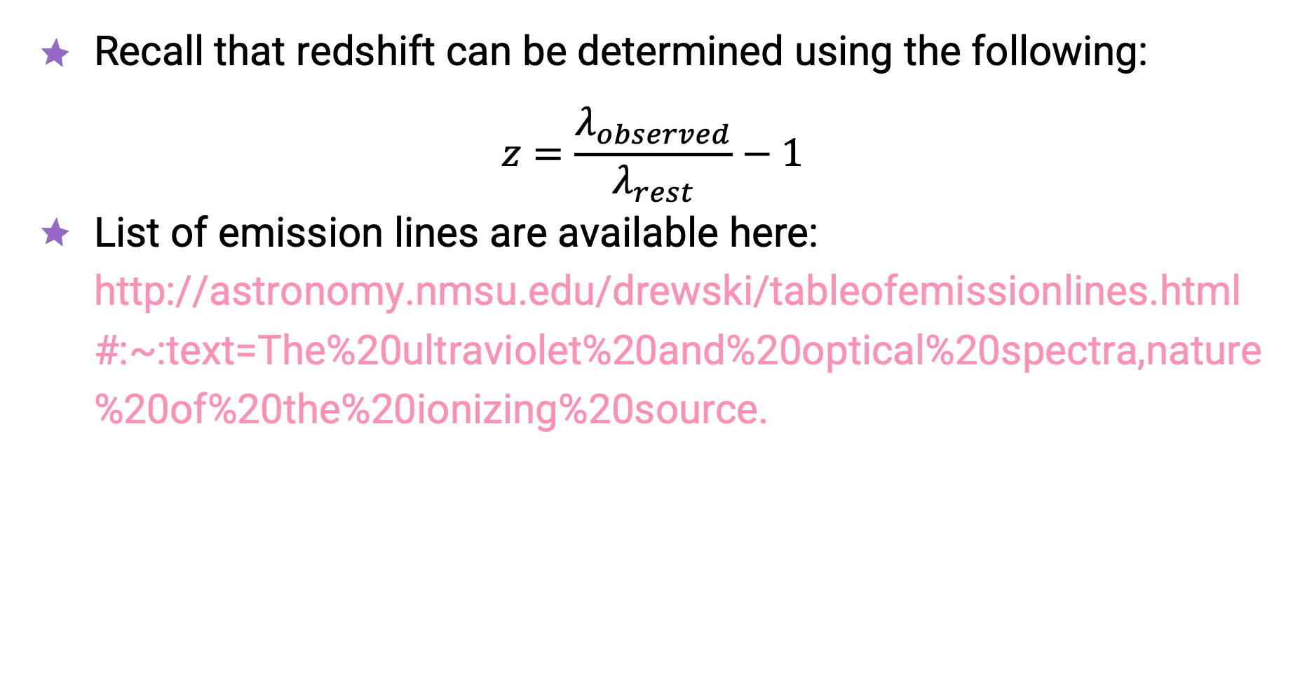
Spectroscopic Redshift
Recall that redshift can be determined using the following:
$$z=\frac{λ_{observed}}{λ_{rest}}−1$$
List of emission lines are available here: http://astronomy.nmsu.edu/drewski/tableofemissionlines.html#:~:text=The%20ultraviolet%20and%20optical%20spectra,nature%20of%20the%20ionizing%20source.

